Slide 1
Datafest 2025
Team Pixel Members:Kinshuk

Slide 2
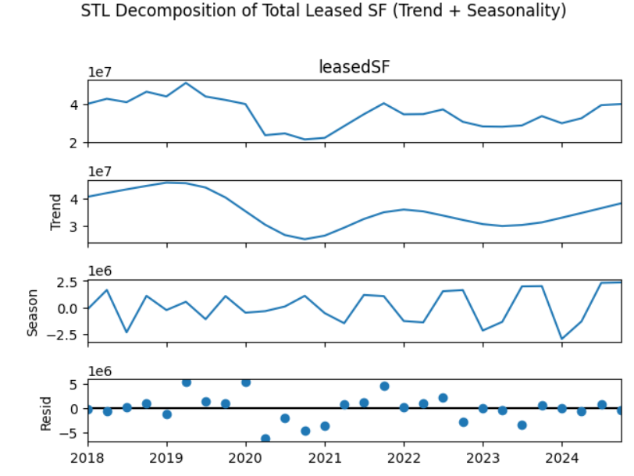
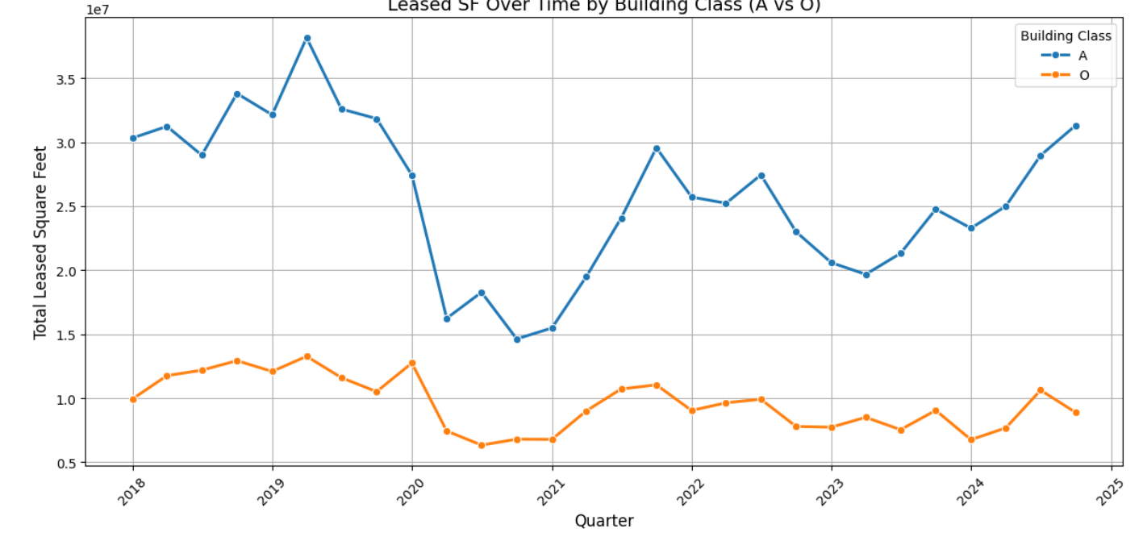
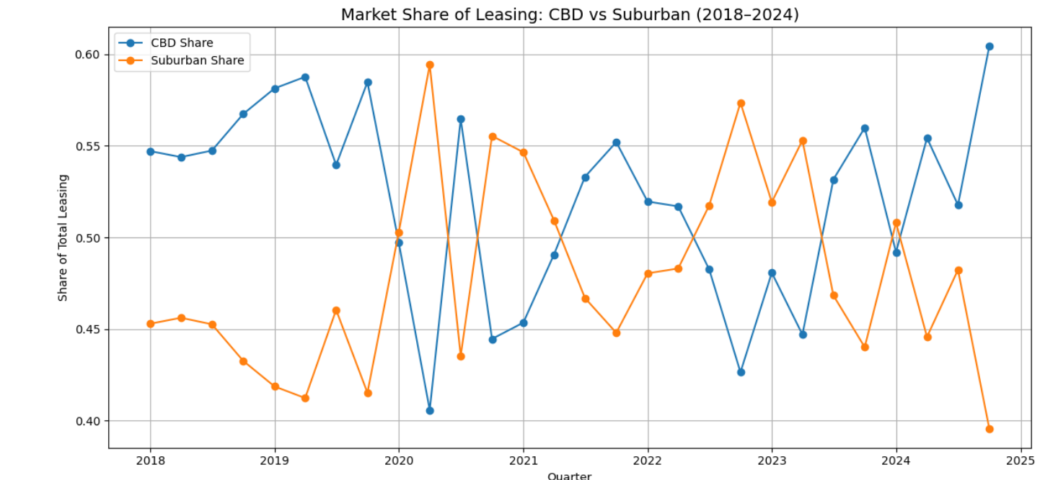
Leasing Collapse, Premium Rebound: The Pandemic’s Market Reshuffle
Macrotrend: Leasing volume collapse & Class A recovery

Slide 3
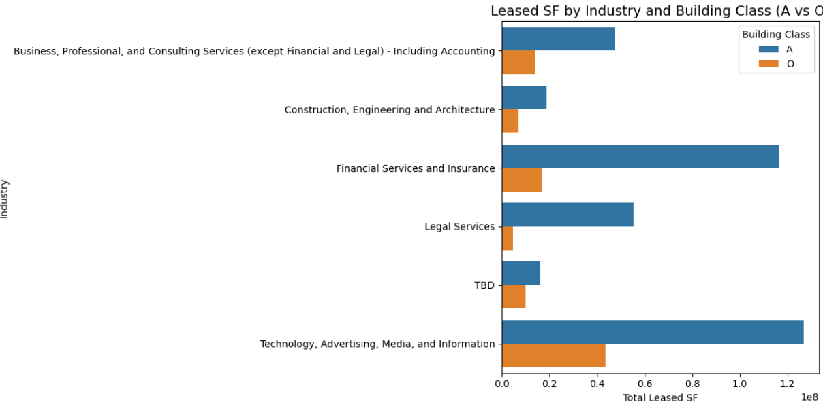
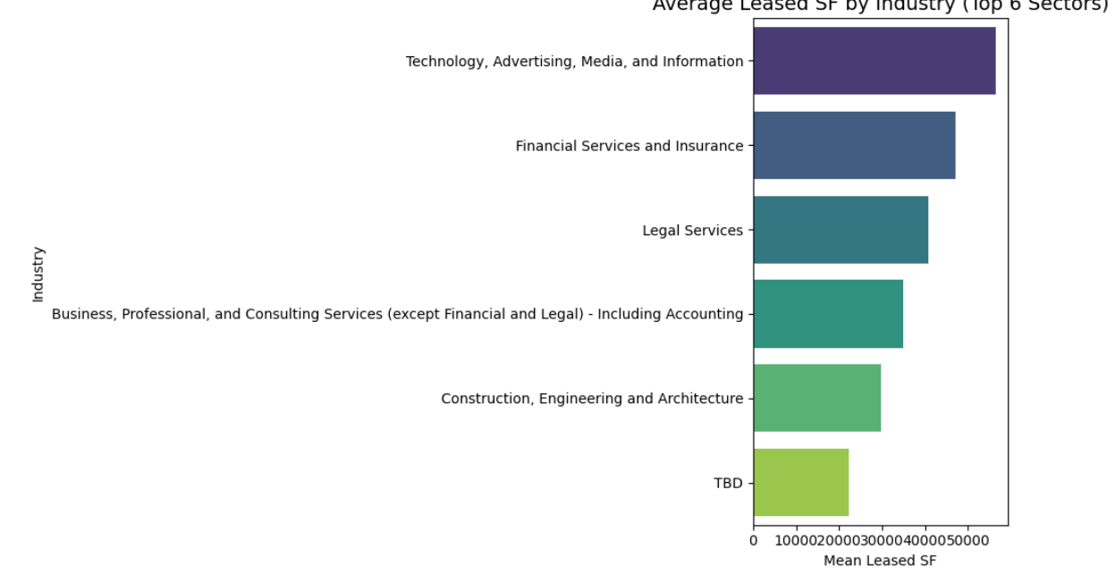
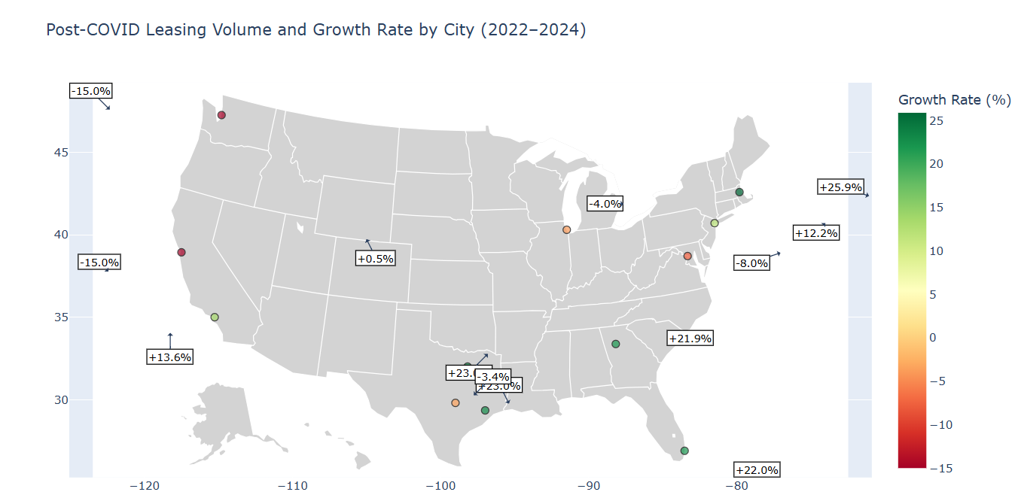
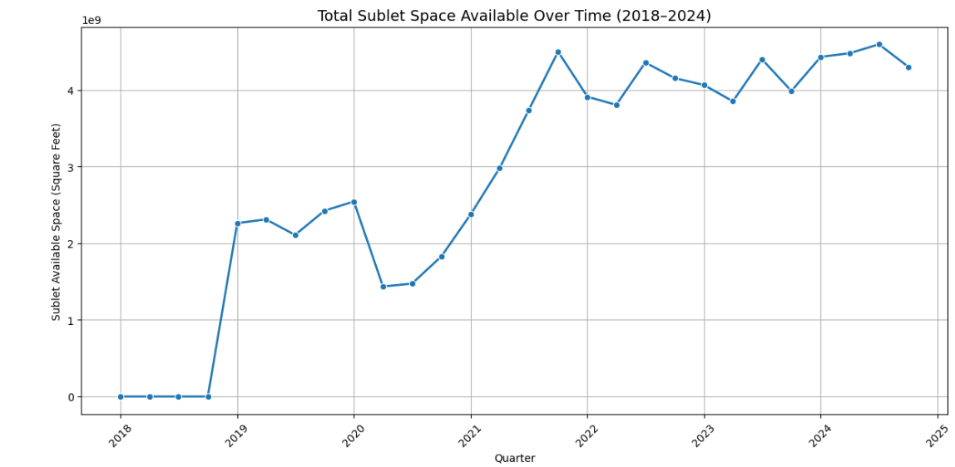
Industry Behavior & The Rise of Subleasing
Microtrend: Subleasing surge & spatial rebalancing by industry

Slide 4
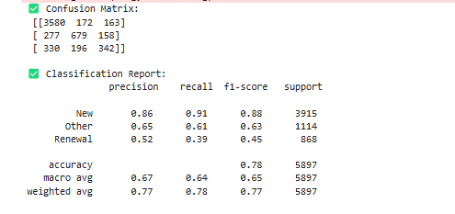
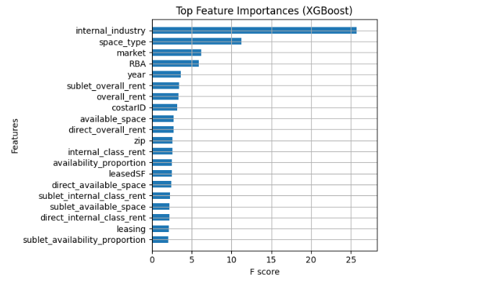
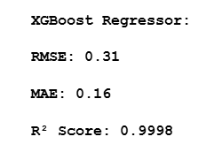
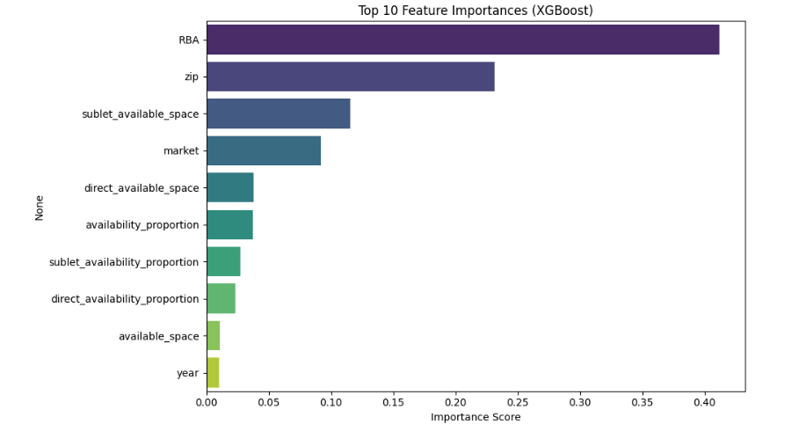
Predictive Modeling – Lease Type & Rent
Microtrend: Lease decisions and rent are highly predictable

